Slide 1
MOVIE DATASET ANALYSIS
GROUP 3(BATCH 2)

Slide 2
BUSINESS IDEA
The dataset can be used by the producers and directors to make similar movies as the top rate and most viewed movies.

Slide 3
OBJECTIVE
We are using Big data tools like HIVE and MapReduce to analyis a given movie dataset, so that it can be further used by concerned clients.
Hive: To access data from the HDFS metastore.
MapReduce: Runs the data analytics jobs.

Slide 4
PROS AND CONS
Pros:
Classifying movies based on highest grossing genre.
Helps investors to invest in top grossing areas
Helping digital platforms to buy rights of top grossing movies.
Cons:
1.There might occur interest clashes among people.
2. No experminents in movies.

Slide 5
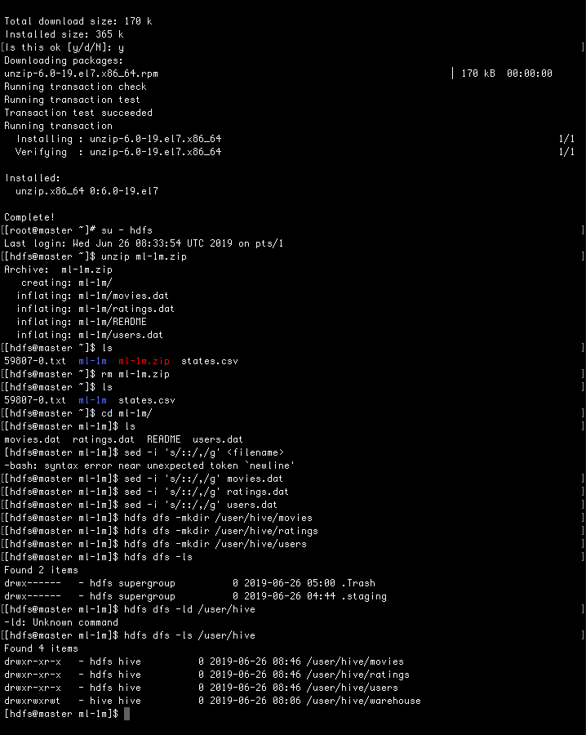
IMPLEMENTATION

Slide 7


Slide 8
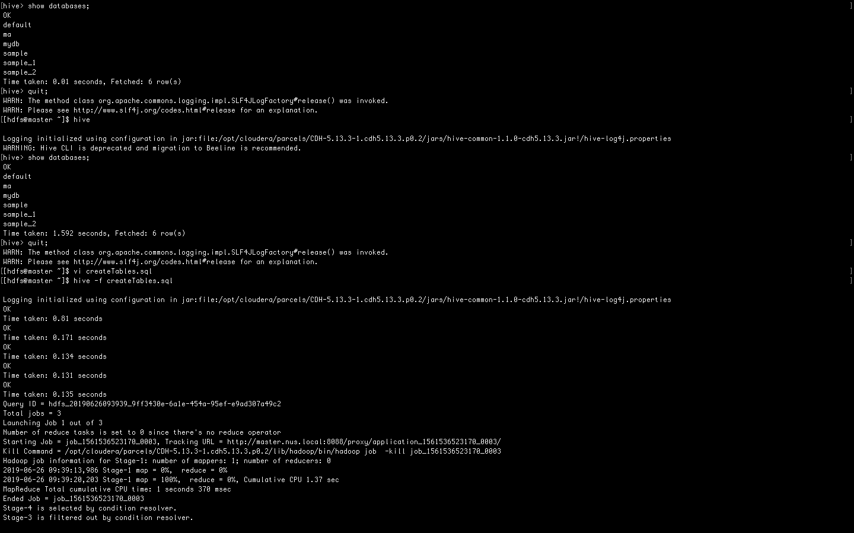

Slide 9
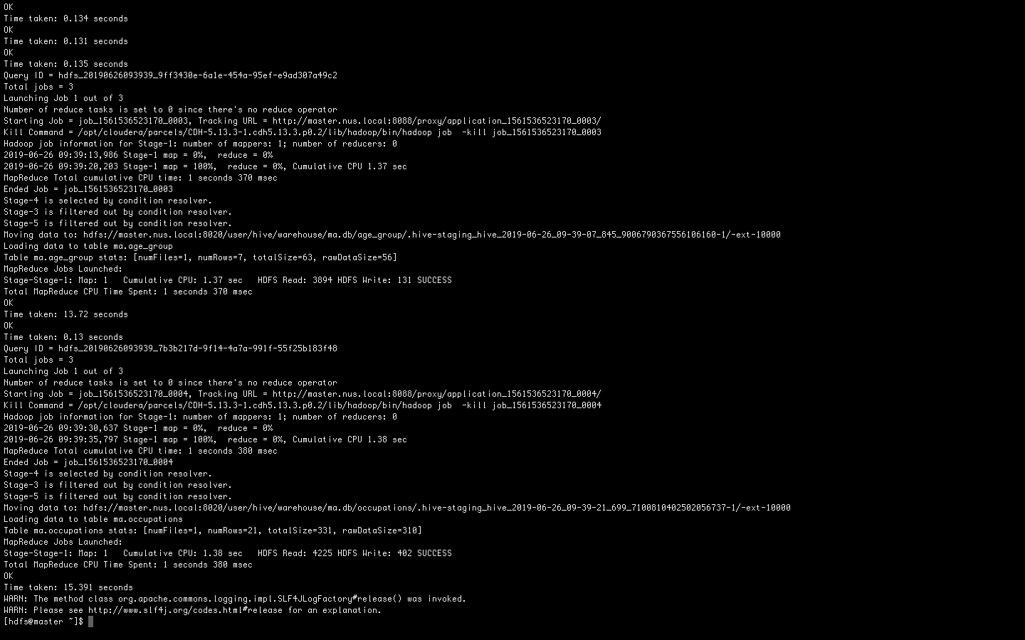

Slide 10
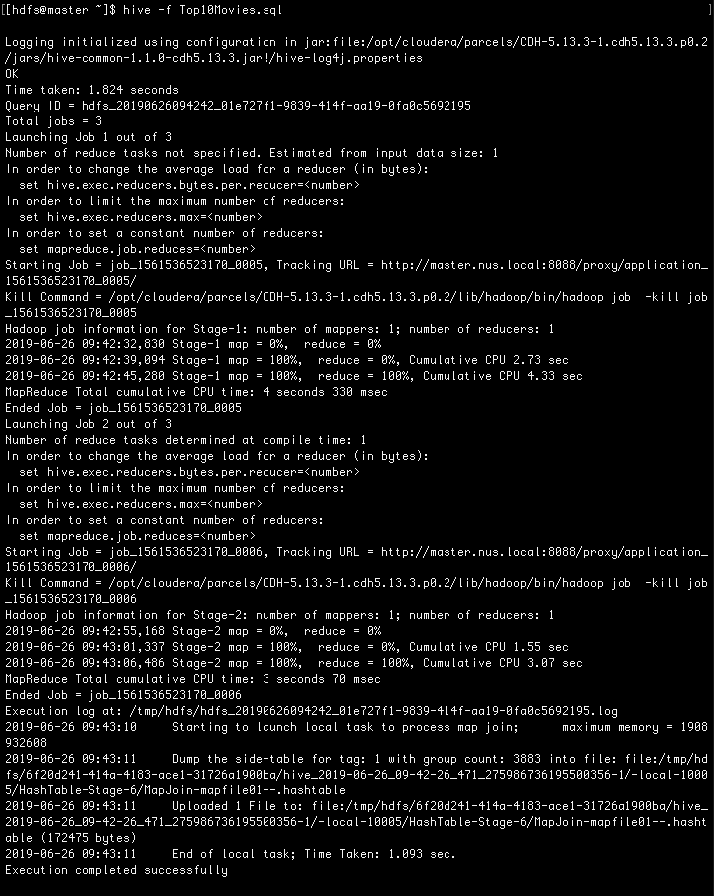

Slide 11
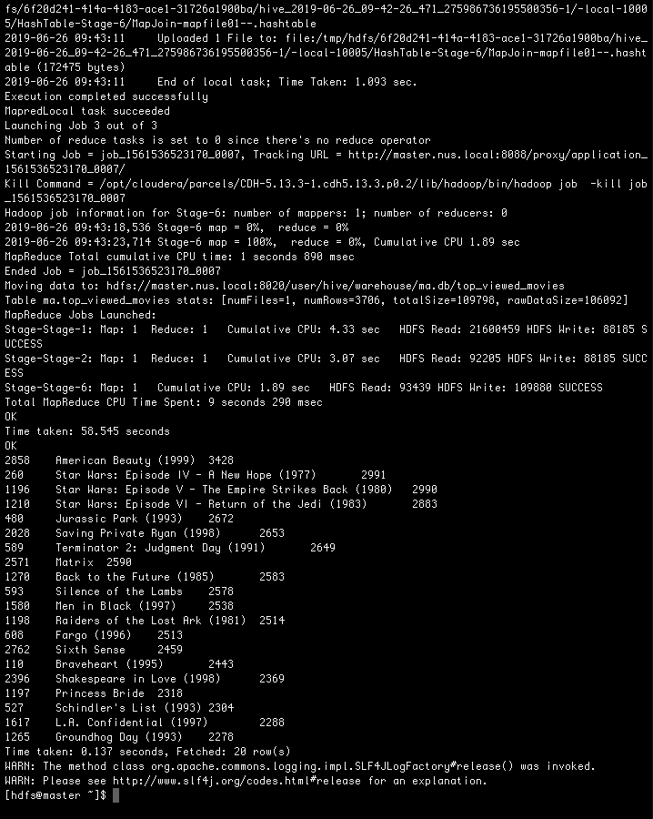

Slide 12
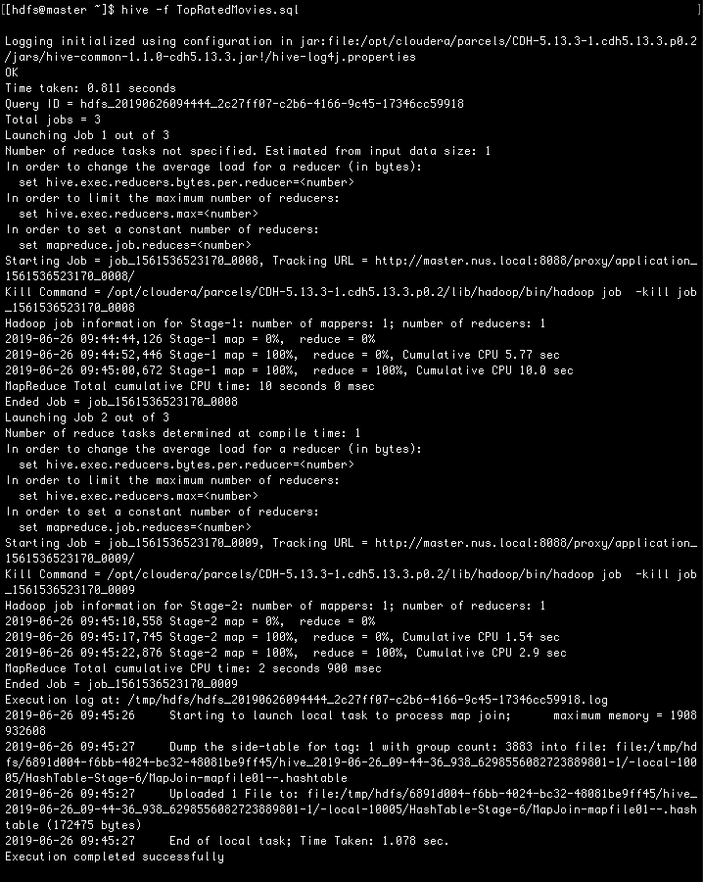

Slide 13


Slide 14
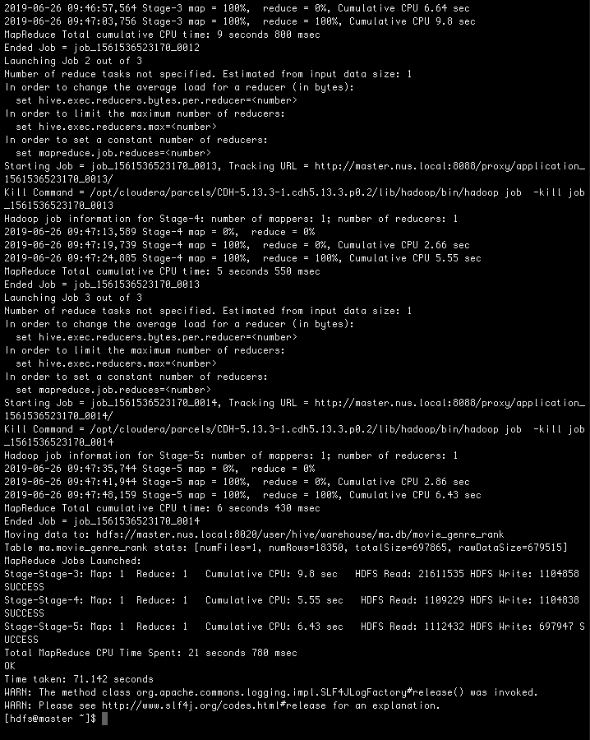

Slide 15
